Slide 1

DataOrbit Healthcare Provider Fraud Detection
A Machine Learning Approach to Safeguard Medicare
Abdelmonem Sayed
Ahmed Mohamed
Eyad Ahmed
Kiro Reda
Danial
Mohanad shehab

Slide 2

Problem Overview
Critical Issue
Project Goal
Healthcare fraud costs billions annually, impacting Medicare integrity.
Develop an interpretable ML pipeline to detect fraudulent Medicare providers.
Key Challenges
High recall and precision needed, severe class imbalance to manage.

Slide 3



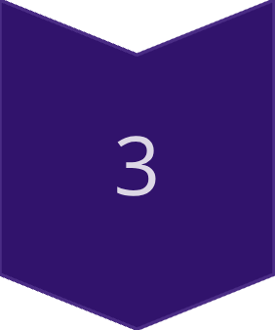

Dataset Structure
Train_Beneficiarydata.csv
Patient demographics and chronic conditions.
Train_Inpatientdata.csv
Inpatient claims (financial, procedural).
Train_Outpatientdata.csv
Outpatient claims.
Train_labels.csv
Provider-level fraud labels (Yes/No).
Key Identifiers: BenefID connects beneficiaries to claims; Provider connects claims to fraud labels.

Slide 4
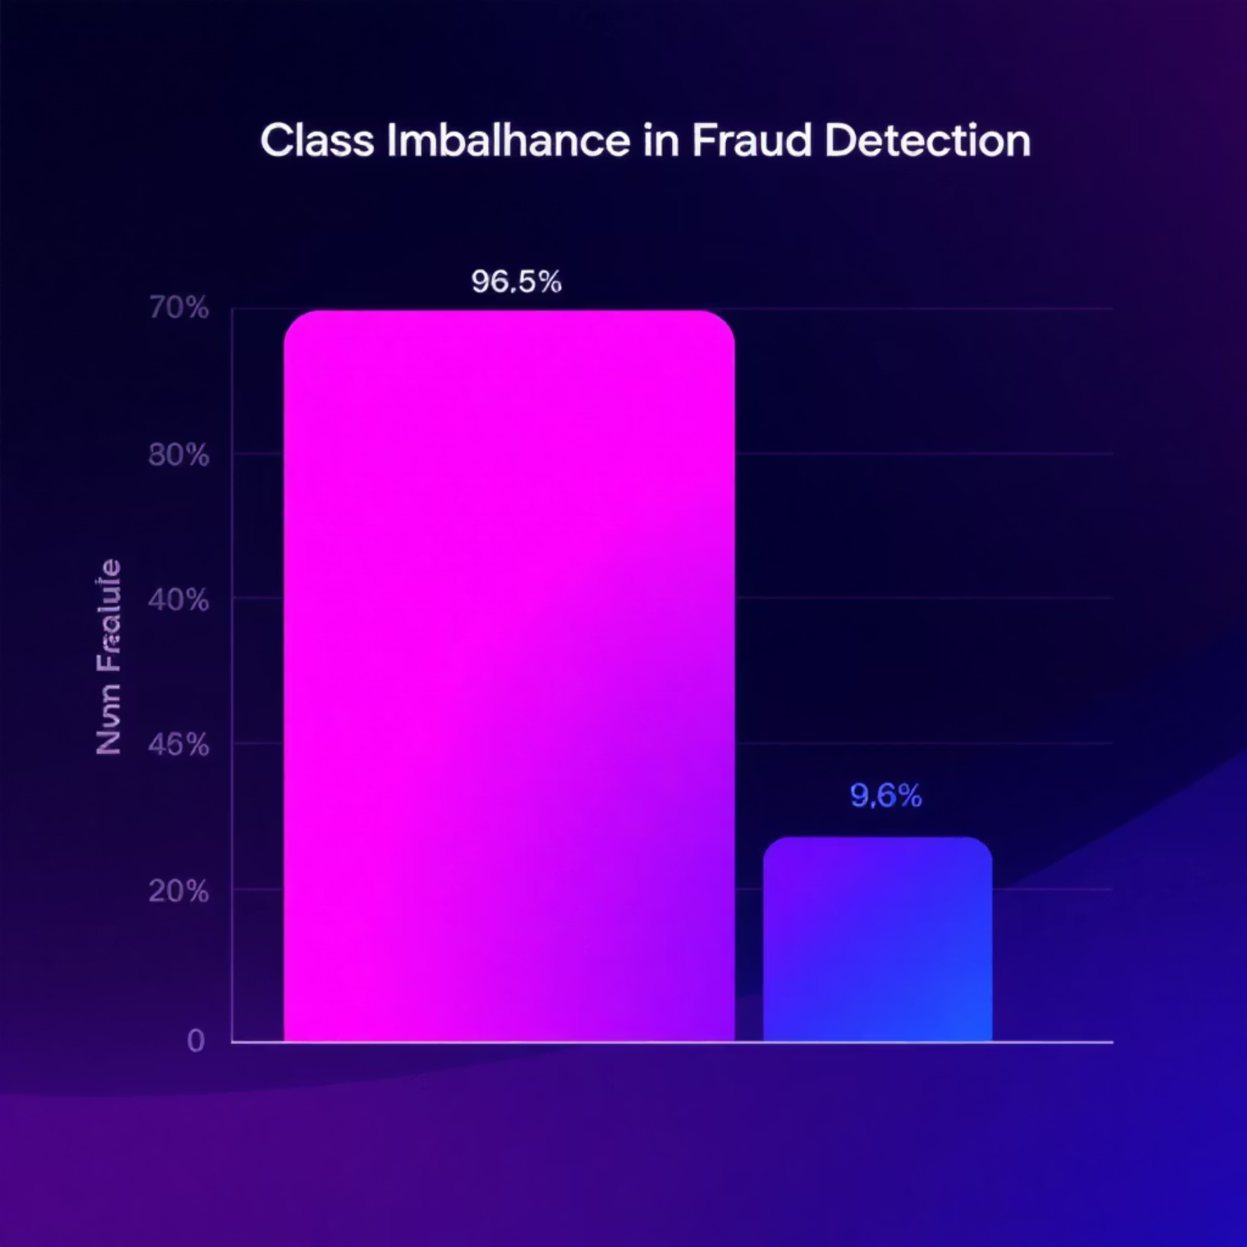
Data Exploration: Key Insights
Dataset Relationships
Exploratory Findings
Beneficiaries linked to Claims via BeneID.
Fraudulent providers show higher claim counts and amounts.
Claims linked to Providers and Fraud Labels via Provider ID.
More inpatient claims per beneficiary.
Modeling unit is Provider-level, requiring claim aggregation.
More chronic conditions among beneficiaries.
Data Quality & Preprocessing
Fraud Distribution
Missing chronic condition values imputed with 0.
Non-Fraudulent: 4661 (96.65%)
Claim amount outliers capped at 99th percentile.
Fraudulent: 586 (9.35%)
Categorical fields one-hot encoded.
Imbalance Ratio: 9.7:1
Datasets merged, duplicates removed.
80/20 stratified train-test split to preserve fraud ratio.

Slide 5









Feature Engineering: Provider-Level Aggregation
We created provider-level features by aggregating inpatient and outpatient tables, aligning with Medicare auditing patterns.
Count Features
Total claims, inpatient claims, outpatient claims.
Financial Features
Mean, sum, max claim amounts.
Beneficiary Features
Unique beneficiaries, average chronic conditions.
Ratios
Inpatient/outpatient ratios, claim-per-beneficiary ratios.

Slide 6


Handling Class Imbalance
With fraud cases at approximately 10%, severe class imbalance was a key challenge.
1
2
Class Weights
SMOTE Oversampling
Best-performing choice, reducing false negatives without oversampling.
Added noise and distorted financial distributions, not preferred.
3
Undersampling
Resulted in significant loss of valuable information.
Final decision: Class-weighted models were chosen to effectively manage the imbalance.

Slide 7





Modeling & Algorithms
We trained and compared various machine learning models to identify the most effective for fraud detection.
Logistic Regression
Random Forest
Decision Tree
Baseline interpretable linear model.
Handles complex non-linear patterns.
Provides simple rule-based behavior.
SVM
XGBoost
Robust for high-dimensional datasets.
Best overall performance, handles imbalance well.

Slide 8
Model Comparison: Results Table
Logistic_Regression
0.901
0.484
0.901
0.630
0.970
0.787
Random_Forest
0.952
0.836
0.604
0.701
0.969
0.785
Decision_Tree
0.908
0.503
0.792
0.615
0.866
0.519
SVM
0.897
0.474
0.891
0.619
0.952
0.579
XGBoost
0.946
0.713
0.713
0.713
0.963
0.784
XGBoost consistently outperformed others in PR-AUC and error balance, making it the chosen final model.

Slide 9

Error Analysis
Understanding false positives and negatives is crucial for model refinement.
False Positive Case 1
Frequent outpatient claims, high diagnosis diversity. Fix: Add temporal stability features.
False Positive Case 2
Many elderly beneficiaries with chronic conditions inflating claim volume. Fix: Add age-adjusted baseline utilization rates.
False Negative Case 1
Small, repeated claims below fraud thresholds. Fix: Add time-series frequency spikes.
False Negative Case 2
Minimal code diversity, suspicious physician-sharing patterns. Fix: Engineer graph-based physician network features.
Largest driver of false positives: demographic complexity. False negatives: under-coding low-amount repeated fraud.

Slide 10




Conclusion & Business Impact
Enhanced Detection
1
Combining inpatient/outpatient patterns significantly improves fraud detection.
Optimal Performance
2
XGBoost delivered the best fraud-detection performance.
Balanced Approach
3
Class weighting was essential for balancing precision/recall.
Future Growth
4
Error analysis suggests additional features for further reduction of false predictions.
This system offers a robust solution to combat healthcare fraud, protecting billions in Medicare funds.

